Slide 1

Vel Tech Rangarajan Dr. Sagunthala R&D Institute of Science and Technology
School of Computing
Department of Information Technology
10211IT224 / FULL STACK APPLICATION DEVELOPMENT (JAVA)
PROJECT REVIEW : MILESTONE PROJECT – 2
Date: 06-05-2026
Smart Campus Event Management System
SDG: SDG No – SDG – 9 Industry, Innovation and Infrastructure
Presented By:
CHADIVE GAYANI – VTU27065 – 23UEIT0069
Courses Handling Faculty:
Dr. Visumathi J/ Professor/ IT

Slide 2
INTRODUCTION
1
Smart Campus Event Management System is a web-based application
Designed to manage campus events, workshops, and seminars
Provides a centralized platform for students and administrators
Students can view upcoming events and register online
Allows students to give feedback after events
Admins can create, update, and delete events
Built using Spring Boot, Spring MVC, and Spring Data JPA
Reduces manual work and paperwork
Improves communication and event participation
Ensures a user-friendly and efficient system
Contributes to building a smart, digital campus environment by making event management faster, organized, and efficient
2
3
4
5
6
7
8
9

Slide 3
PROBLEM STATEMENT
1
In many colleges, event management is handled through manual or semi-digital methods
Students often face difficulty in finding accurate and updated event information
Event registrations are time-consuming and not well-organized
Lack of centralized system leads to miscommunication between students and admins
Tracking participate details and feedback is inefficient and error-prone
Admins face challenges in managing, updating, and analyzing event data
Existing systems do not support easy filtering and searching of events
There is no proper system to analyze participation and generate statistics
These issues result in reduced student participation and poor event management
Therefore, there is a need for a system that builds a smart, digital campus environment by making event management faster, organized, and efficient
2
3
4
5
6
7
8
9

Slide 4
OBJECTIVE(S)
To design and develop a web-based Smart Campus Event Management System for efficient event creation, registration, and management
To implement secure, user-friendly features with event filtering and performance tracking to improve participation and administrative efficiency
1
2
3
4
5
6
7
8
9

Slide 5
PROPOSED SYSTEM
1
Provides a web-based centralized system for managing all campus events
Allows students to easily browse and register for events online
Enables admins to create, update, and delete events efficiently
Reduces manual work and paperwork in event management
Improves communication between students and administrators
Supports event filtering (date, department, type) for quick search
Maintains accurate records of registrations and feedback
Helps in analyzing event participation using statistics
Ensures secure access with authentication for admin users
Provides real-time updates of events and registrations
Enhances overall efficiency and user experience in campus event management
2
3
4
5
6
7
8
9

Slide 6
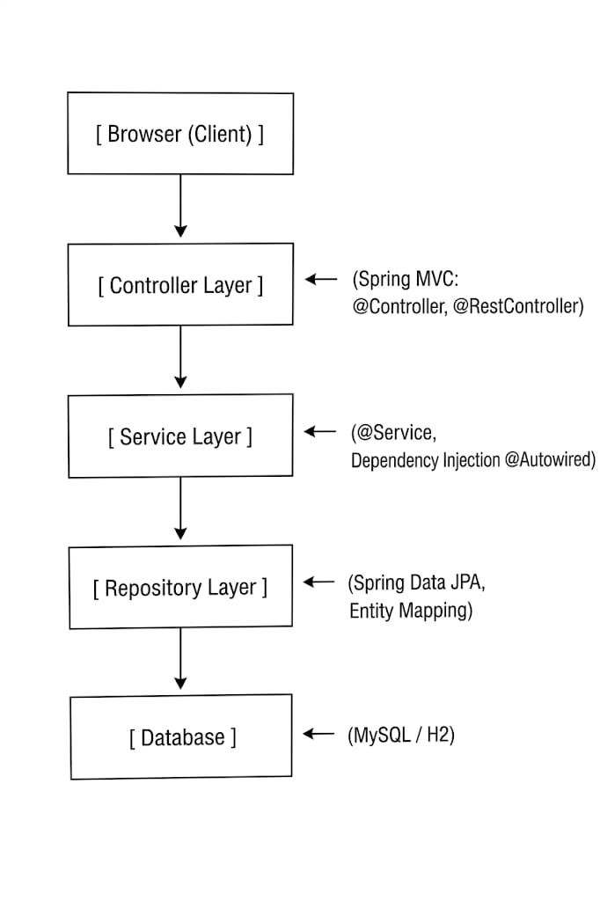
PROPOSED SYSTEM ARCHITECTURE
1
2
3
4
5
6
7
8
9

Slide 7
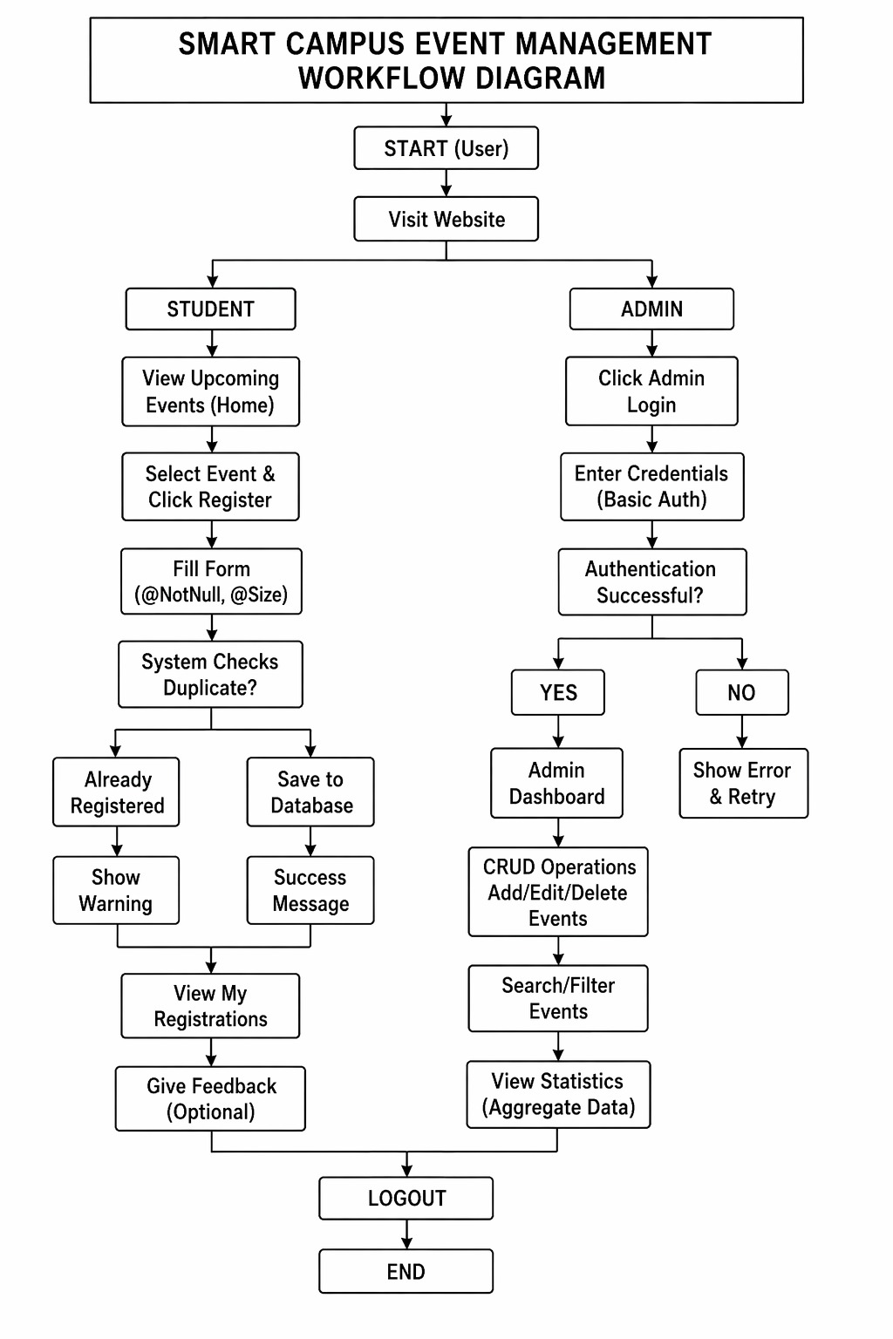
WORKFLOW
1
2
3
4
5
6
7
8
9

Slide 8
TECHNOLOGIES USED
1
Frontend: HTML5, CSS3, Thymeleaf (templating engine)
Backend: Spring Boot, Spring MVC, Spring Core (Dependency Injection), Spring Data JPA
Database: MySQL (or H2 for development)
Tools: Maven, Eclipse/IntelliJ, Git, Postman (for REST API testing)
Hardware/Software Requirements:
Any OS (Windows/Linux/macOS)
JDK 11+
Any modern browser
Embedded Tomcat (comes with Spring Boot)
2
3
4
5
6
7
8
9

Slide 9
MODULE DESCRIPTION
1
Module 1 – User Management:
Handles student login and admin authentication (basic auth). No separate registration for students – admin can add students.
Module 2 – Event Management (CRUD):
Admin can create, read, update, delete events using Spring Boot + JPA.
Module 3 – Student Event & Registration:
Students browse events, register for events with validation, view their registered events.
Module 4 – Search & Filters:
Search/filter events by date, department, or type.
Module 5 – Reporting & Analytics:
View event registration statistics using aggregate functions (COUNT, GROUP BY).
2
3
4
5
6
7
8
9

Slide 10
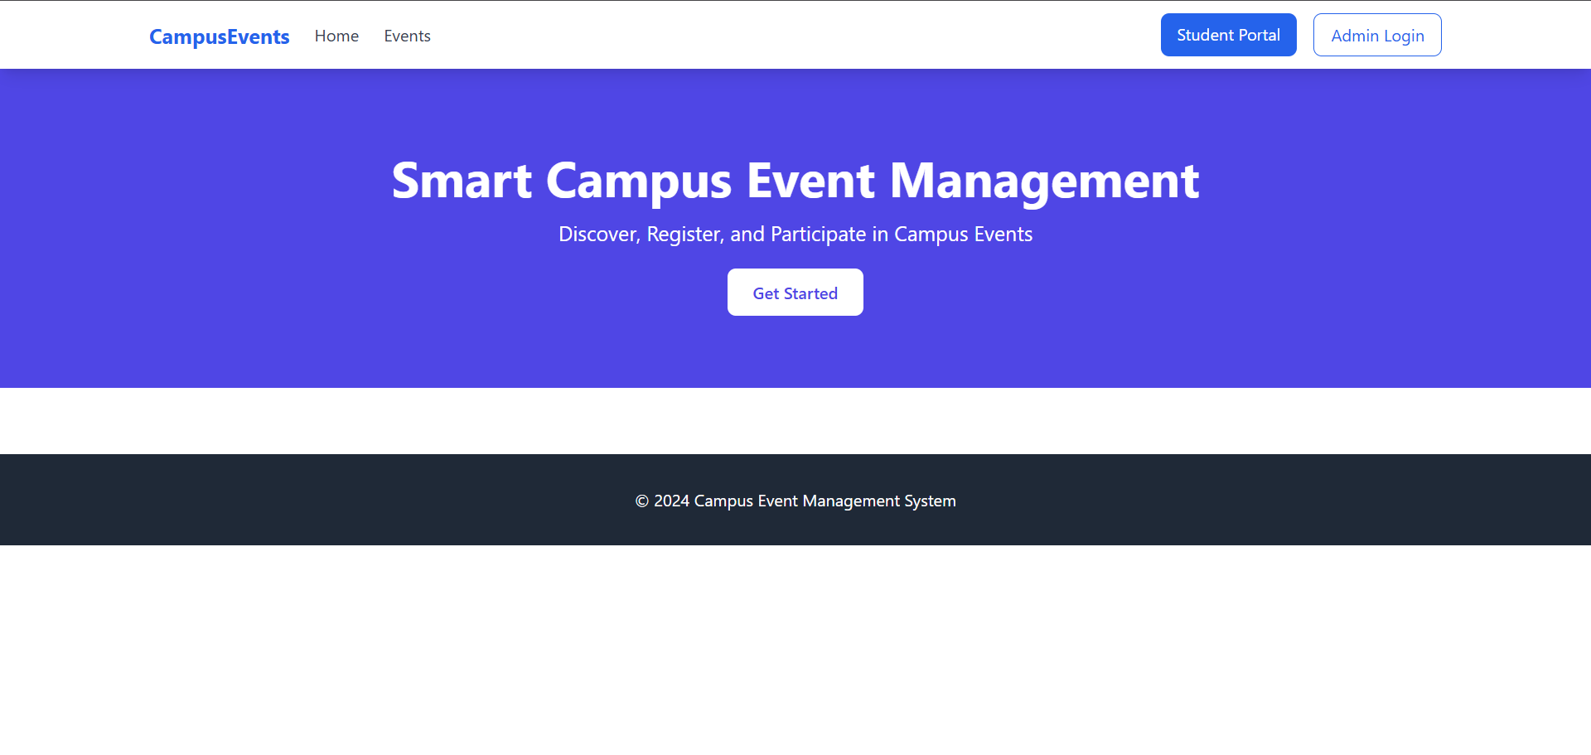
IMPLEMENTATION SCREENSHOTS
1
2
3
4
5
6
7
8
9

Slide 11
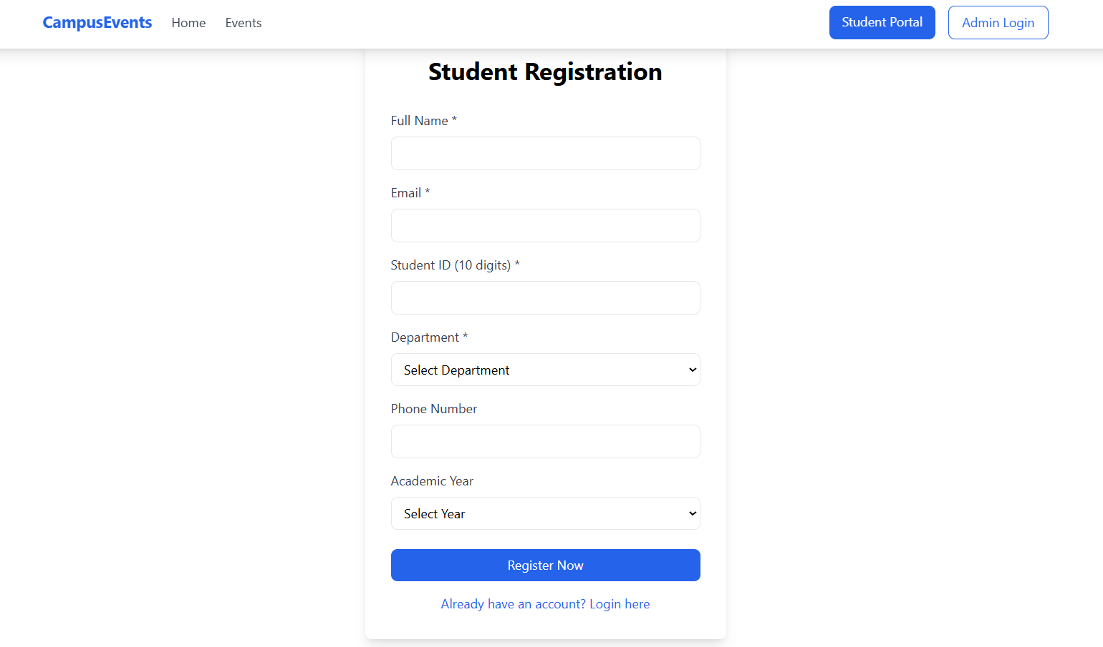
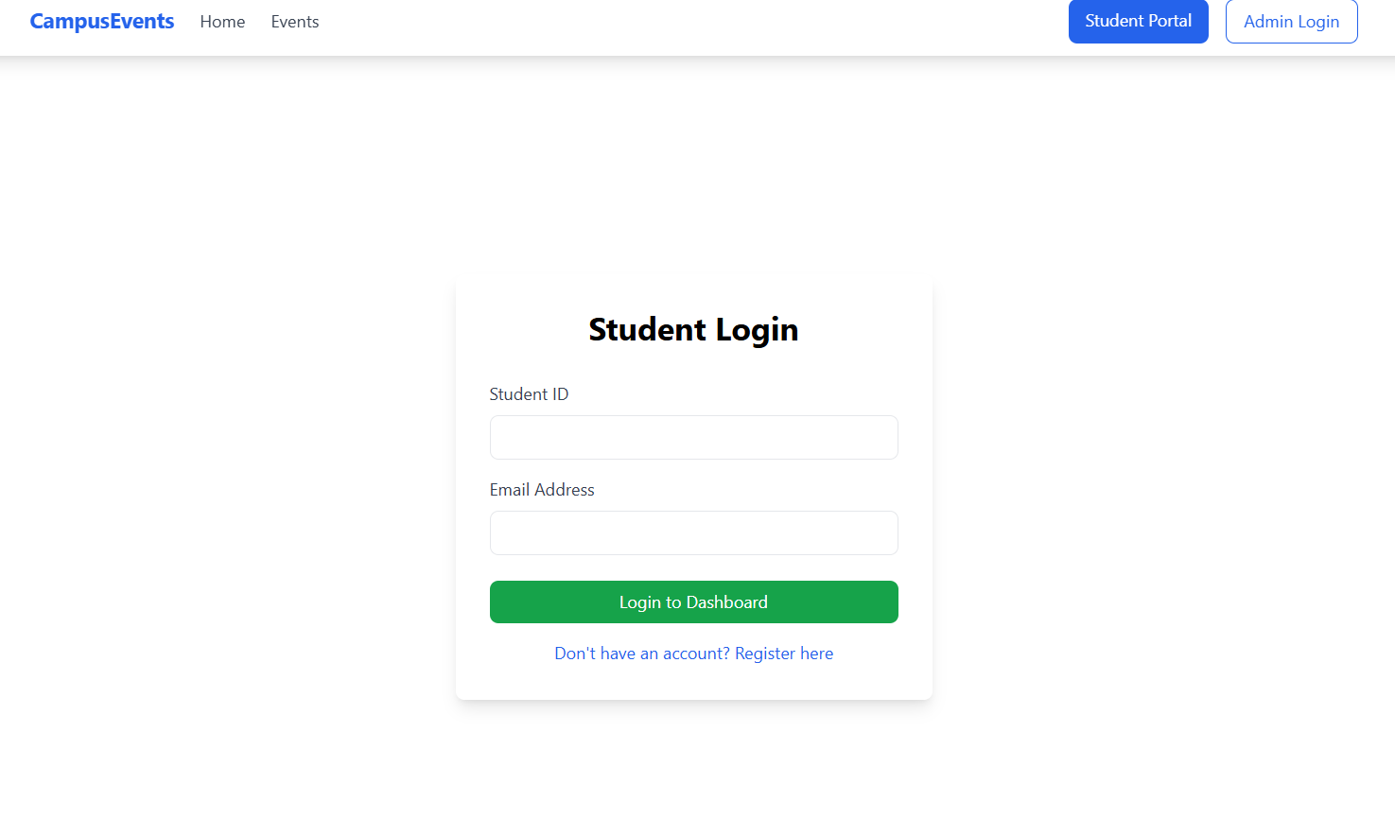
IMPLEMENTATION SCREENSHOTS
1
2
3
4
5
6
7
8(A)
9

Slide 12
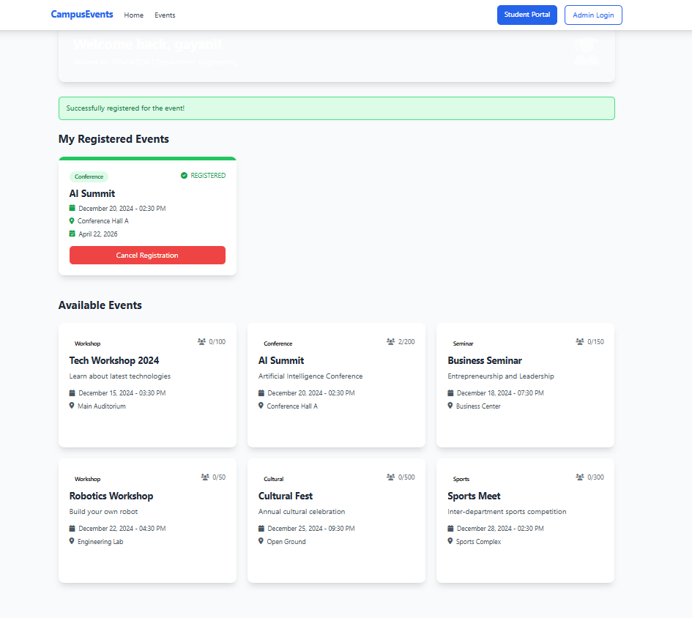
IMPLEMENTATION SCREENSHOTS
1
2
3
4
5
6
7
8(B)
9

Slide 13
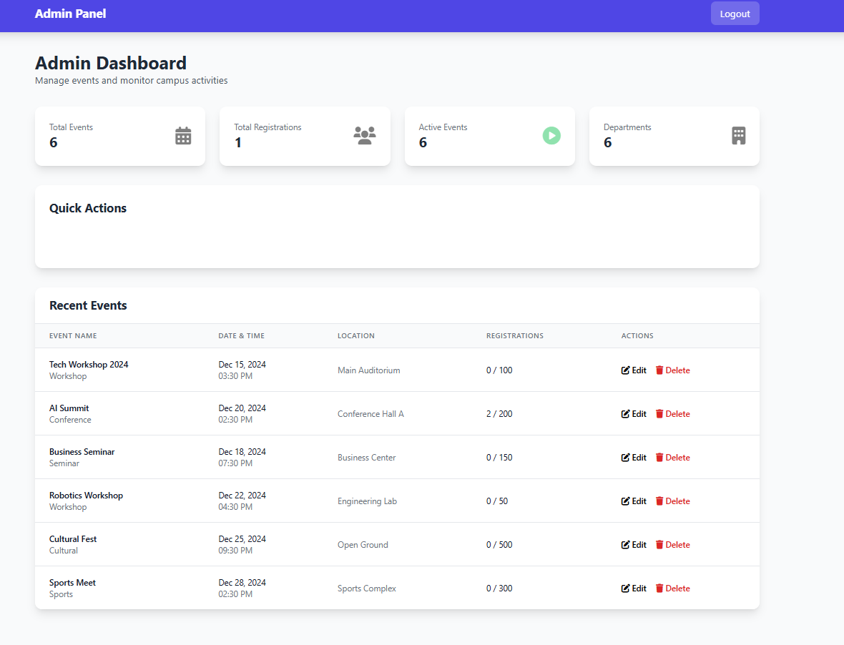
IMPLEMENTATION SCREENSHOTS
1
2
3
4
5
6
7
8(C)
9

Slide 14
ADVANTAGES & LIMITATIONS
1
Advantages
Fully automated event discovery and registration.
Reduces manual workload for admins.
Real‑time event updates and statistics.
Role‑based access ensures security.
Scalable and easy to maintain (Spring Boot architecture).
Limitations
No email/SMS notification system (can be added later).
Basic authentication only – no OAuth or role hierarchy.
Limited to campus use; no public event booking.
Feedback feature is minimal (can be extended).
2
3
4
5
Advantages
6
7
8
9

Slide 15
Thank you

